Slide 1
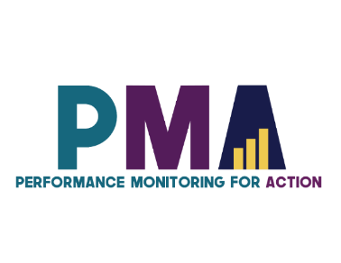
www.pmadata.org/stlr
We invite you to use and adapt PMA STLR tools!
Whatever tool you discover and intend to try out, you will need to adapt these tools to
your context. This may include:
Changing questionnaire question text: Some tools contain questions from our questionnaires (publicly available here), along with their numbering. Note that, in some cases, question numbering has changed across phases, but any questions cited in a tool use consistent numbering within that tool.
Considering appropriate pronouns: We use female pronouns quite often, as PMA worked with female enumerators – and as a bonus, we are happy to use a feminine pronoun by default for a change!
TIP: Use our hashtag system!
As we used these tools across various country contexts, we developed a simple system of using hashtags as placeholders for information that will need to be updated based on the country, context, culture, and program.
For example, information in a tool that was country-specific is noted with the hashtag placeholder, #countryspecific – or possibly an even more specific placeholder like #districtlevel or #localpartner.
Information that required a change in date is noted with hashtags such as #todaysdate or #lastyear.
These hashtags allow those adapting the tool to use the Find&Replace function to quickly identify and update all instances of a hashtag within seconds.

Slide 2
Qualities of a Good Phone-Based Resident Enumerator
This presentation goes into more depth about phone interview techniques for resident enumerators and provides practical scenarios to act out during training sessions. Presenting different role-playing exercises can help enumerators practice how to address common challenges that can occur during a phone interview, brainstorm, and discuss solutions. This presentation works as a great companion to the presentation "Introduction to Phone Interviewing".
When adopting, adapting, and sharing this tool, please use this suggested citation:
“Qualities of a good phone-based resident enumerator”, created by PMA (Performance Monitoring for Action) with Sarah Nehrling. Released June 2024. CC BY-NC 4.0.

Slide 3
Qualities of a Good Phone-Based Resident Enumerator

Slide 4
There are 4 Key Challenges to keeping a respondent engaged during a phone-based interview

Slide 5
1
It is much easier to hang up on an interviewer than to refuse an interview in person.
Be professional and charming.
Put more emphasis on a high-quality study introduction, through tone, voice, friendliness, etc.

Slide 6
2
The refusal rate is higher for these types of surveys. There are fewer friendly, informal discussions as you are not face-to-face with the respondent.
Prepare responses to typical respondent questions.
Interviewers who can make a respondent feel comfortable have a higher response rates.
Notes:
This is why you should prepare a few responses to your respondents’ questions. Interviewers who are able to make a respondent feel comfortable have a higher response rates. Regardless of the interviewer’s skills, there will be refusals. Don’t get discouraged!

Slide 7
3. Requires that the interviewer frequently confirms that the respondent is still on the line using active listening hints.
3
You cannot see if the respondent is still on the line!
Are you there, Mrs. Kaboré?
Can you hear me?
Thank you for your response; we’re already half-way through the interview.
Use active listening hints to confirm frequently that the respondent is still on the line.
Notes:
3) When you are calling a respondent, you cannot see the look on the respondent’s face. What does the look on this woman’s face tell you? (That she is perhaps reluctant to talk to you)

Slide 8
4
Your respondent was not expecting you to call today. Maybe not ever. They’re surprised, disoriented, and may or may not remember you or the survey.
As with an in-person survey, be flexible in the beginning of the survey (before informed consent).
Have a conversation with the respondent. Don’t just read the script.
Notes:
4) More specifically, do not read the script in the beginning of the questionnaire. Once you have the respondent’s consent, you may read the questions exactly as they are written.

Slide 9
Scenario #1:
Similarities and differences
Identify 3 similarities with face-to-face interviews
Identify 3 differences from face-to-face interviews
Notes:
#countryspecific – We encourage country teams to come up with their own scenarios to act out for training.
Scenario #1 should focus on study introduction for a phone interview and should highlight the differences in study introduction between an interview conducted in-person and one conducted over the phone.
Suggested structure:
While watching the scenario, half of the REs should identify 3 similarities with face-to-face interviews, while the other half of the room/REs identify 3 differences.
Discussion : 7 min
Ask the REs to share their similarities and differences.
Some items to note:
She repeated the questions and responses a lot (Active listening)
Did she build rapport/trust?
How about the pace of the conversation?

Slide 10
Scenario #2:
Difficulties and enjoyable aspects
In your opinion, what challenges could you face during phone-based data collection?
Are there any aspects that are easier or more enjoyable compared to face-to-face surveys?
Notes:
#countryspecific – Have REs imagine that they are conducting follow-up client exit interview over the phone. Ask discussion questions.
Notes:
Reflection time: 5 minutes
Discussion: 5 minutes
Probing questions:
Lack of trust is a challenge. How can you build rapport/trust between you and the respondent?
How would you feel if a stranger called you?

Slide 11
A good interviewer should be able to tell when a respondent…
becomes irritated
loses interest
misunderstood a question
hesitates to answer a question
is confused or uncomfortable
Notes:
2 minutes
Over the phone, you should listen to understanding everything!
… based on both verbal and non-verbal hints, including the tone/sound of the respondent’s voice and the expressions she uses.

Slide 12
4 Techniques to improve the quality of interactions
Notes:
#countryspecific: For each of the 4 techniques, consider conducting a role-playing activity after each explanation. Then one interviewer should try using the technique in front of the others; finally, they may practice in pairs.

Slide 13
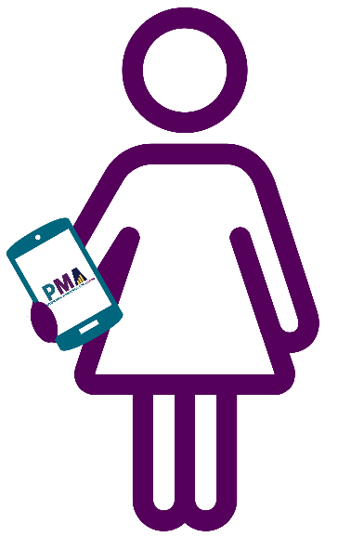
1
Use short and informal wording,
to promote conversation.
It is always more interesting when there are interactions during a phone call than when the interviewer talks a lot.
What if I were to explain that in another way, so that you might understand it a little better and be able to respond with a bit more precision and clarity?
Let me try again.

Slide 14
2
Follow the respondent’s pace and tone.
Pay attention to the pace and tone of your first interactions with the respondent and try to match it.
If they speak slowly, you should speak slowly.
If they are very formal, you should also speak formally.
Hello! Can I talk to Mrs. Abby?
This is she. To whom do I, Madame Abby Diaw Diallo, have the pleasure of speaking this morning?
How might you respond? …

Slide 15
3
Take time to build comfort and trust with the respondent, to ensure the most accurate and complete responses.
If you start collecting information too quickly, before the respondent is comfortable, they may not be willing to share information.
Mrs. Abby, I’m Julie from PMA. Are you currently married or living together with a man as if married?
Who are YOU to ask about the man living in my house???

Slide 16
4
Encourage the respondent,
especially when she is stuck on a response.
If the respondent does not know how to respond, continue the conversation by asking her an open question, or encouraging her to talk about her concerns or about what she does not understand.
…
What might you say to encourage the respondent?
…
What is an example of an open question you might ask?
…

Slide 17
5
Avoid apologizing!
Avoid sentences such as “Do you have a few minutes to spare?” or “Would you mind answering a few questions?
These questions give the respondent an opportunity to end the call and make it difficult to convince her to continue the interview.
Do you have a few minutes to talk to me today?
I do NOT.
I am busy.

Slide 18
Pop Quiz!
If someone calls YOU for an interview, what information do you need before you can agree to continue?
Give some examples of direct probes.

Slide 19
If someone calls you for an interview, what information do you need before you can agree to continue?
Their name
His/her role
The name/activity of the organization
A description of the survey
Notes:
Put yourself in the respondent's shoes: If someone were to randomly call you for a survey, what is the minimum amount of information YOU would need to know to know if you wanted to proceed.

Slide 20
Did you know…
The decision to participate in a survey is often made in less than 30 seconds after making contact with a respondent.
Therefore, it is critical to quickly introduce the survey to provide information on the identity of the interviewer and the research organization, explanations on the research itself and its significance, information ensuring the confidentiality of the survey, as well as compelling reasons to encourage respondents to participate.

Slide 21
When a respondent picks up the phone, you should do 6 things in the first 30 seconds…
Greet the respondent
Clarify the language the respondent prefers speaking
Introduce yourself
Tell the respondent why you are calling her
Answer all the respondent’s questions
Be confident and control the discussion

Slide 22
1. Greet the respondent
Greet the respondent before introducing yourself.
For wary respondents, you should take more time to reassure them.
You may talk about something else or extend a greeting so that you may earn her trust; this is not always necessary if you deem that she already trusts you.
For respondents open to continuing, you should proceed to introducing the survey and ask her if she has any questions. Asking her if she has any questions will further reassure her.
Notes:
You should greet her politely. This will be slightly different for each person. When greeting the respondent, you should be able to identify her language (next slide)

Slide 23
2. Clarify the language the respondent prefers speaking
You should know a priori what language the respondent speaks.
But you should confirm what language she understands best.
Language is a key factor of quality data collection.
If you speak the same language, ask her: “Should we continue in [#countryspecific - Language]?”
Notes:
#countryspecific – update to include a country-specific language
It is not always necessary to ask this question, but it is important as if you do not conduct the interview in the right language, data quality will be low.

Slide 24
3. Introduce yourself
Your first name, and your last name if you feel comfortable sharing it
Let the respondent know that you are not mistaken – you are trying to reach her.
Some respondents hang up as they believe you called them by mistake/dialed a wrong number. You should be ready to handle this situation so you can try to keep her on the line.

Slide 25
4. Tell the respondent why you are calling her
Discuss the subject in general, present the study in a clear and concise manner; do not go into details now
Where you are (what city)
What institution is conducting the survey
How important her opinion is
Her questions and concerns
Notes:
Additional notes:
You are calling for a survey (perhaps stay vague in the beginning; do not start with FP); you should have a conversation with your respondent.
Where are you (what city) and with what institution (give the information that will be the easiest to understand for the respondent), as oftentimes, people want to know in what city the interviewer is.
Try to find out if there are any additional questions or concerns.

Slide 26
5. Answer all the respondent’s questions
Do not try to rush the respondent into responding to your questions.
It is important to answer all of the respondent’s questions before continuing to introduction and screening questions.
An interviewer who speaks the respondent’s language fluently can clearly respond to her concerns.
A respondent will trust someone who speaks her language more.

Slide 27
Respondents’ most frequent concerns
Where are you?
Why are you calling me?
Where did you get
my number?
Will the interview last long?
Notes:
For each question, an interviewer should try to answer this question.
Respondents should be reassured that this is not a joke.

Slide 28
6. Be confident and control the discussion
At this stage, if the interviewer asks if a respondent would like to talk at a different time, the respondent will probably say yes, so there is no need to confirm again.
Don’t be sorry and avoid sentences such as “Would you have a few minutes so spare?” or “Would you mind answering a few questions?”

Slide 29
12 Important Skills of a phone-based interviewer
While these skills also apply to in-person interviews,
they are even more important for phone-based interviewing.
Confidence
Understanding the respondent’s reaction
Presentation
Persuasion capacity
Active listening
Pacing the conversation
Flexibility
Enunciation
Modulation
Neutrality
Probing

Slide 30
Scenario #3 – Survey introduction
How did she do?
Reached out to the respondent over the phone with a friendly greeting
Introduced herself by her first name, last name, role and organization
Mastered introducing the subject and the objective
Notes:
#countryspecific – We encourage country teams to come up with their own scenarios to act out for training.
Scenario #3 – Replay the same scenario that you used for scenario #1, paying more attention this time to the three points on this slide.
Notes:
Discussion: 3 min (Did the interviewer follow the 3 necessary parts of an introduction?)

Slide 31
Scenario #4 – Talking with ease and confidence
Not enough - The interviewer seems to have little confidence, to be shy, hesitating.
Adequate - The interviewer talks with ease, while respecting her interlocutor.
Too much - The tone of the interviewer sounds arrogant, preemptory, and/or abrupt.
Notes:
#countryspecific – We encourage country teams to come up with their own scenarios to act out for training.
Scenario #4 is all about speaking with confidence and having a flexible enough interview style to keep the interview both conversational and on-track. For this scenario, the interviewer should repeat the same interaction with the respondent four different times, each time highlighting an extreme version of confidence or flexibility:
1st time: Not enough confidence
2nd time: Too much confidence
3rd time: Not enough flexibility
4th time: Too much flexibility

Slide 32
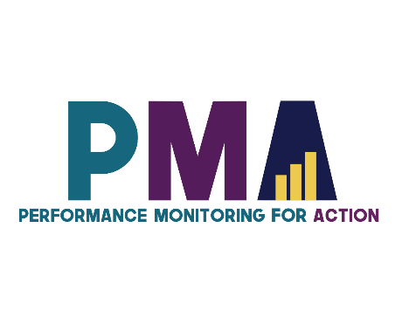
Thank you!
pma2020.org
/pm4action
@pm4action
@pm4action

Slide 33
Image sources:
Slides 6 & 26: All images from Microsoft 365 stock images
Slide 10: Businessman destroying phone by Gan Khoon Lay from Noun Project (CC BY 3.0)
Slide 10: Angry phone call by Gan Khoon Lay from Noun Project (CC BY 3.0)
Slide 10: Phone call problem by Gan Khoon Lay from Noun Project (CC BY 3.0)
Slide 10: Complain by Gan Khoon Lay from Noun Project (CC BY 3.0)
Slide 14: Outgoing Call by shwepes from Noun Project (CC BY 3.0)

